Slide 1
Arm & Hammer Animal Nutrition Always stay on the lead lap.

Slide 2
overview
The A-MAXTM Advantage
Go For Maximum Performance
Fueling Winners
Pre-Race Research Pays
See the A-MAX Difference
Beat the Heat
Formulas for Success
Fuel Up: Recommended Feeding Rates

Slide 3
The a-maxTM advantage
Produced with a proven strain of Saccharomyces cerevisiae
Makes more nutrients available to your animals
Helps prepare for the demands of growth, production and maintenance^{†‡ ∆ Ω}
† Bruno R, Santos J, Rutieliano H, Cerri R, Robinson P. The effect of feeding A-MAX Yeast Culture on performance of high-producing dairy cows in summer heat
stress. Animal Feed Science and Technology 2009;150:175-186. University of California-Davis. Research Bulletin 3.
‡ Nocek JE, Holt MG, Oppy J. Effects of supplementation with yeast culture and enzymatically hydrolyzed yeast on performance of early-lactation dairy cattle.
J Dairy Sci 2011;94(8). Spruce Haven Farms, New York. Research Bulletin D-28.
∆ Netherlands Trial. Research Bulletin 64.
Ω Hoover WH, Miller-Webster TK. The Effect of A-MAX Yeast Culture and Diamond V Yeast Culture on Microbial Metabolism in Continuous Culture. West Virginia
University; Research Bulletin 7. J Dairy Sci 2002;85:2009-2014.

Slide 4
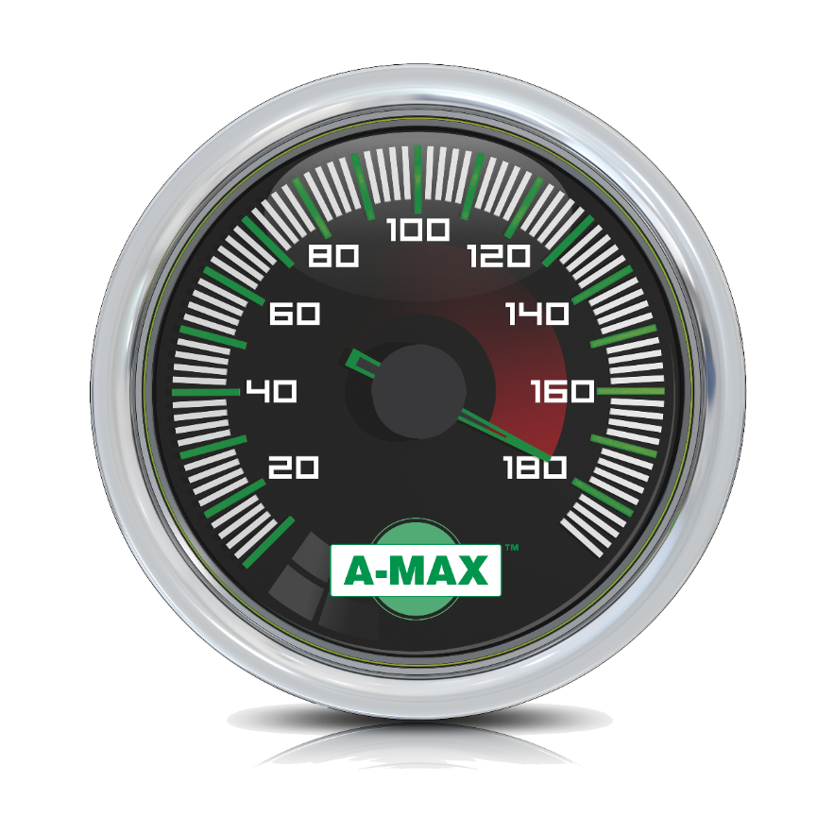
Go for maximum performance
Delivers high levels of peptides, amino acids and vitamins
Helps animals digest feed more efficiently^{Ω}
Enhances rumen metabolism in dairy cattle
Proven to increase milk production †‡ ∆
Helps animals maintain performance during heat stress †
† Bruno R, Santos J, Rutieliano H, Cerri R, Robinson P. The effect of feeding A-MAX Yeast Culture on performance of high-producing dairy cows in summer heat
stress. Animal Feed Science and Technology 2009;150:175-186. University of California-Davis. Research Bulletin 3.
‡ Nocek JE, Holt MG, Oppy J. Effects of supplementation with yeast culture and enzymatically hydrolyzed yeast on performance of early-lactation dairy cattle.
J Dairy Sci 2011;94(8). Spruce Haven Farms, New York. Research Bulletin D-28.
∆ Netherlands Trial. Research Bulletin 64.
Ω Hoover WH, Miller-Webster TK. The Effect of A-MAX Yeast Culture and Diamond V Yeast Culture on Microbial Metabolism in Continuous Culture. West Virginia
University; Research Bulletin 7. J Dairy Sci 2002;85:2009-2014.

Slide 5
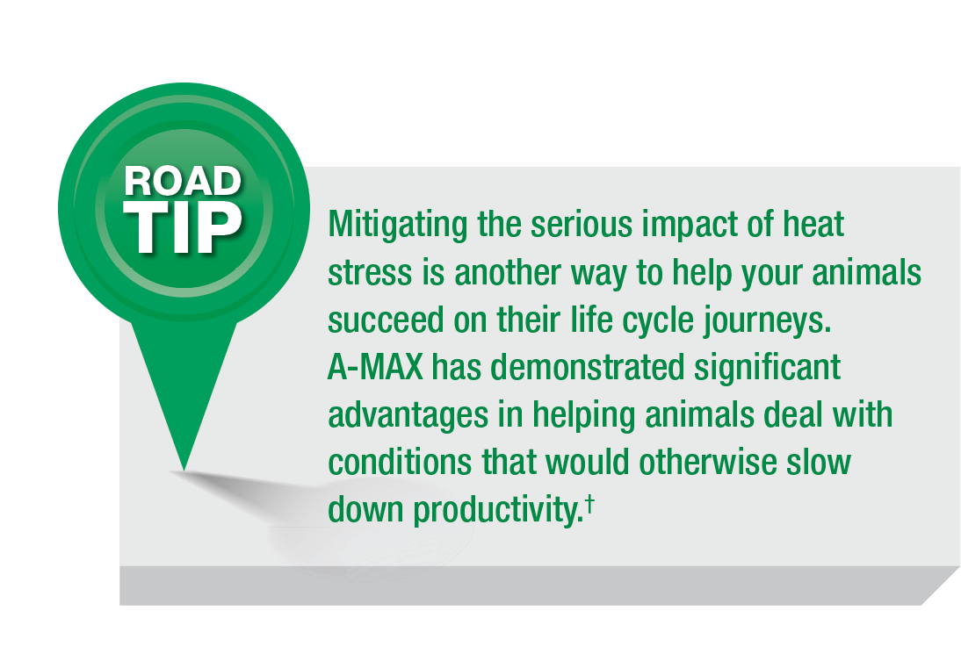
Fueling winners
In recent studies†‡ ∆, feed efficient A-MAX has consistently proven itself to be the winning formula in the race to productivity
† Bruno R, Santos J, Rutieliano H, Cerri R, Robinson P. The effect of feeding A-MAX Yeast Culture on performance of high-producing dairy cows in summer heat
stress. Animal Feed Science and Technology 2009;150:175-186. University of California-Davis. Research Bulletin 3.
‡ Nocek JE, Holt MG, Oppy J. Effects of supplementation with yeast culture and enzymatically hydrolyzed yeast on performance of early-lactation dairy cattle.
J Dairy Sci 2011;94(8). Spruce Haven Farms, New York. Research Bulletin D-28.
∆ Netherlands Trial. Research Bulletin 64.

Slide 6
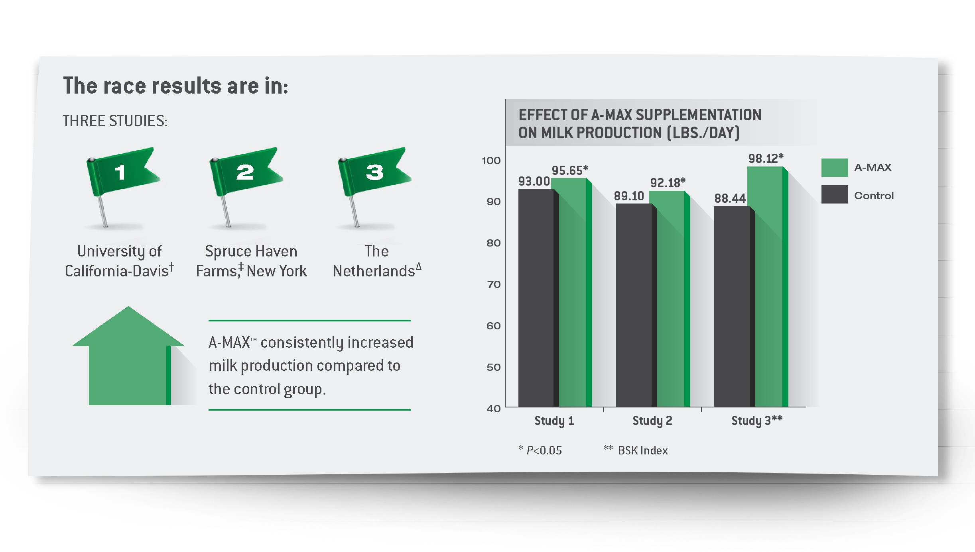
Pre-race research pays
† Bruno R, Santos J, Rutieliano H, Cerri R, Robinson P. The effect of feeding A-MAX Yeast Culture on performance of high-producing dairy cows in summer heat
stress. Animal Feed Science and Technology 2009;150:175-186. University of California-Davis. Research Bulletin 3.
‡ Nocek JE, Holt MG, Oppy J. Effects of supplementation with yeast culture and enzymatically hydrolyzed yeast on performance of early-lactation dairy cattle.
J Dairy Sci 2011;94(8). Spruce Haven Farms, New York. Research Bulletin D-28.
∆ Netherlands Trial. Research Bulletin 64.

Slide 7
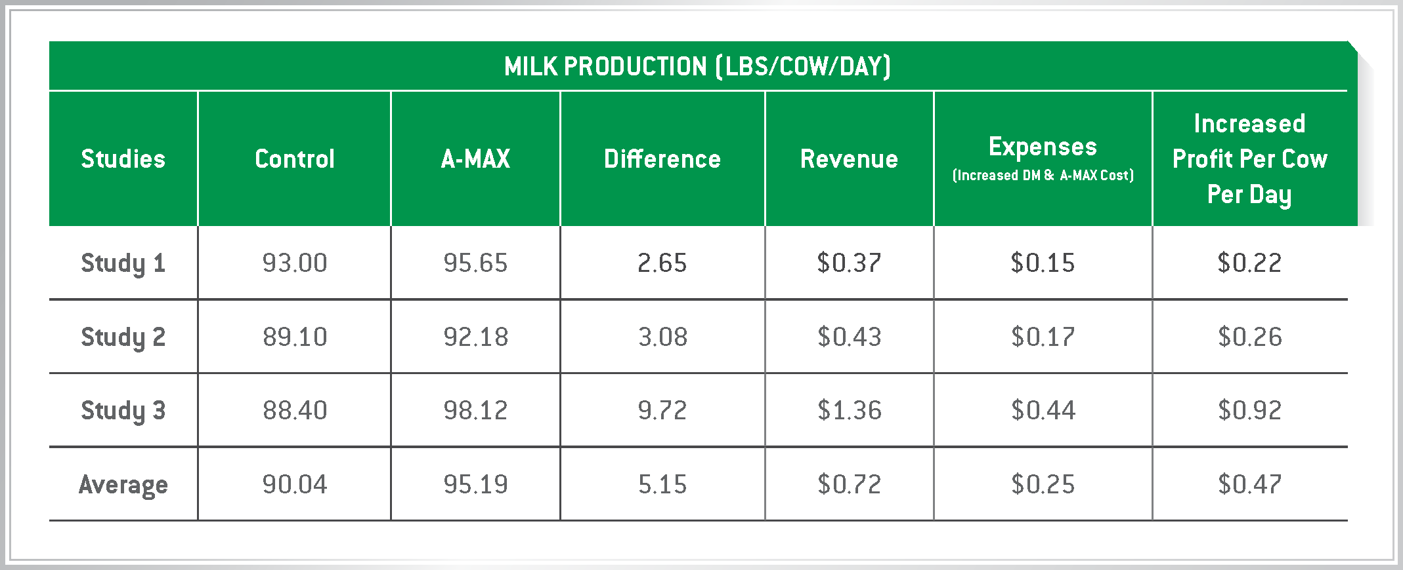
See the a-max difference
Across all three studies A-MAX increased milk production and profits

Slide 8
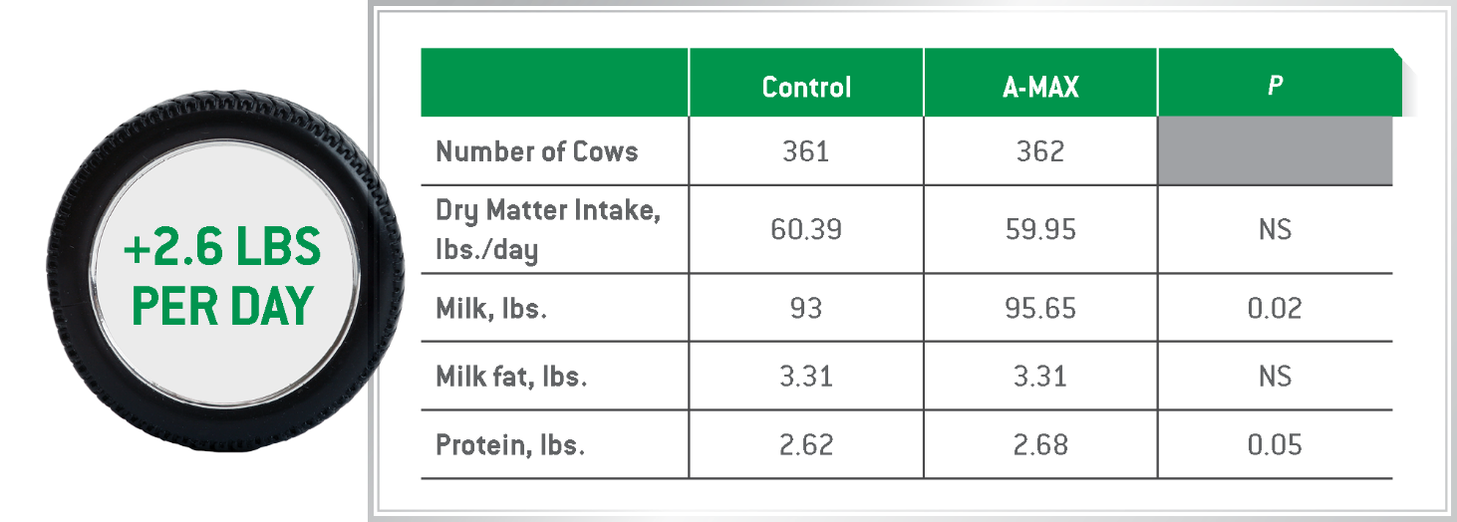
beat the heat
Study results show cows fed A-MAX yeast in hot, ambient temperatures maintained dry matter intake while increasing milk production by 2.6 lbs. per day†
† Bruno R, Santos J, Rutieliano H, Cerri R, Robinson P. The effect of feeding A-MAX Yeast Culture on performance of high-producing dairy cows in summer heat
stress. Animal Feed Science and Technology 2009;150:175-186. University of California-Davis. Research Bulletin 3.

Slide 9
† Bruno R, Santos J, Rutieliano H, Cerri R, Robinson P. The effect of feeding A-MAX Yeast Culture on performance of high-producing dairy cows in summer heat stress. Animal Feed Science and Technology 2009;150:175-186. University of California-Davis. Research Bulletin 3.

Slide 10
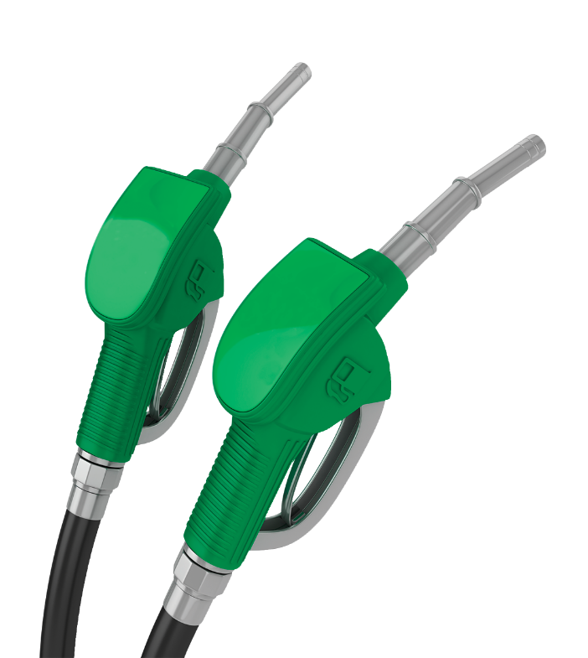
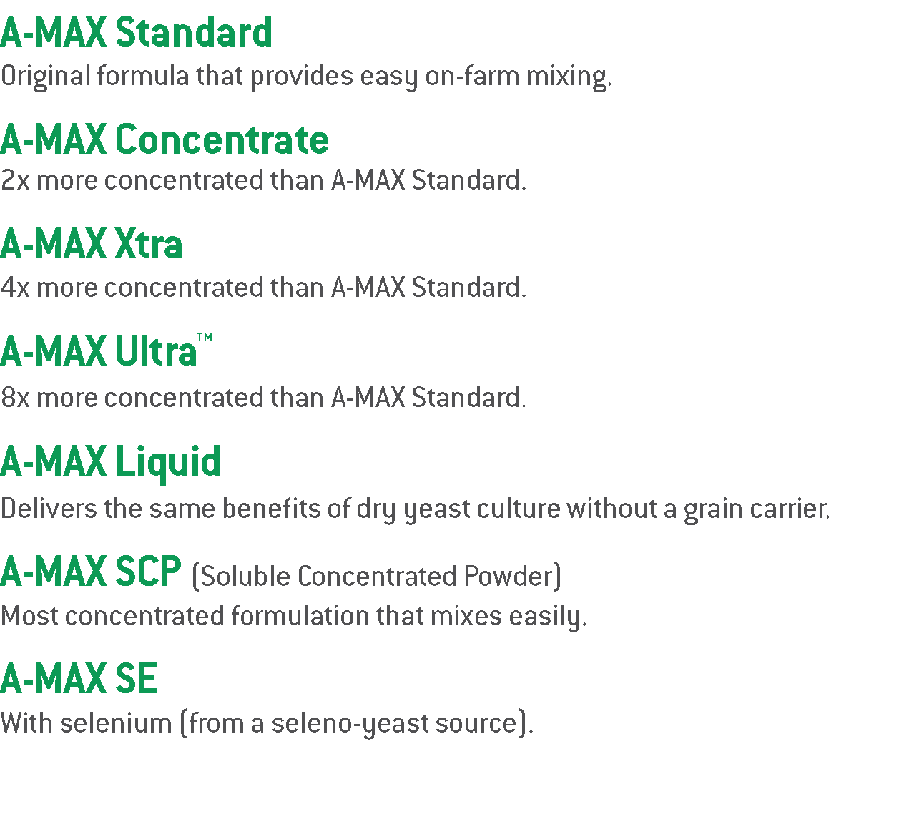
Formulas for success
Fuel up your dairy herd with the right feed solutions:

Slide 11
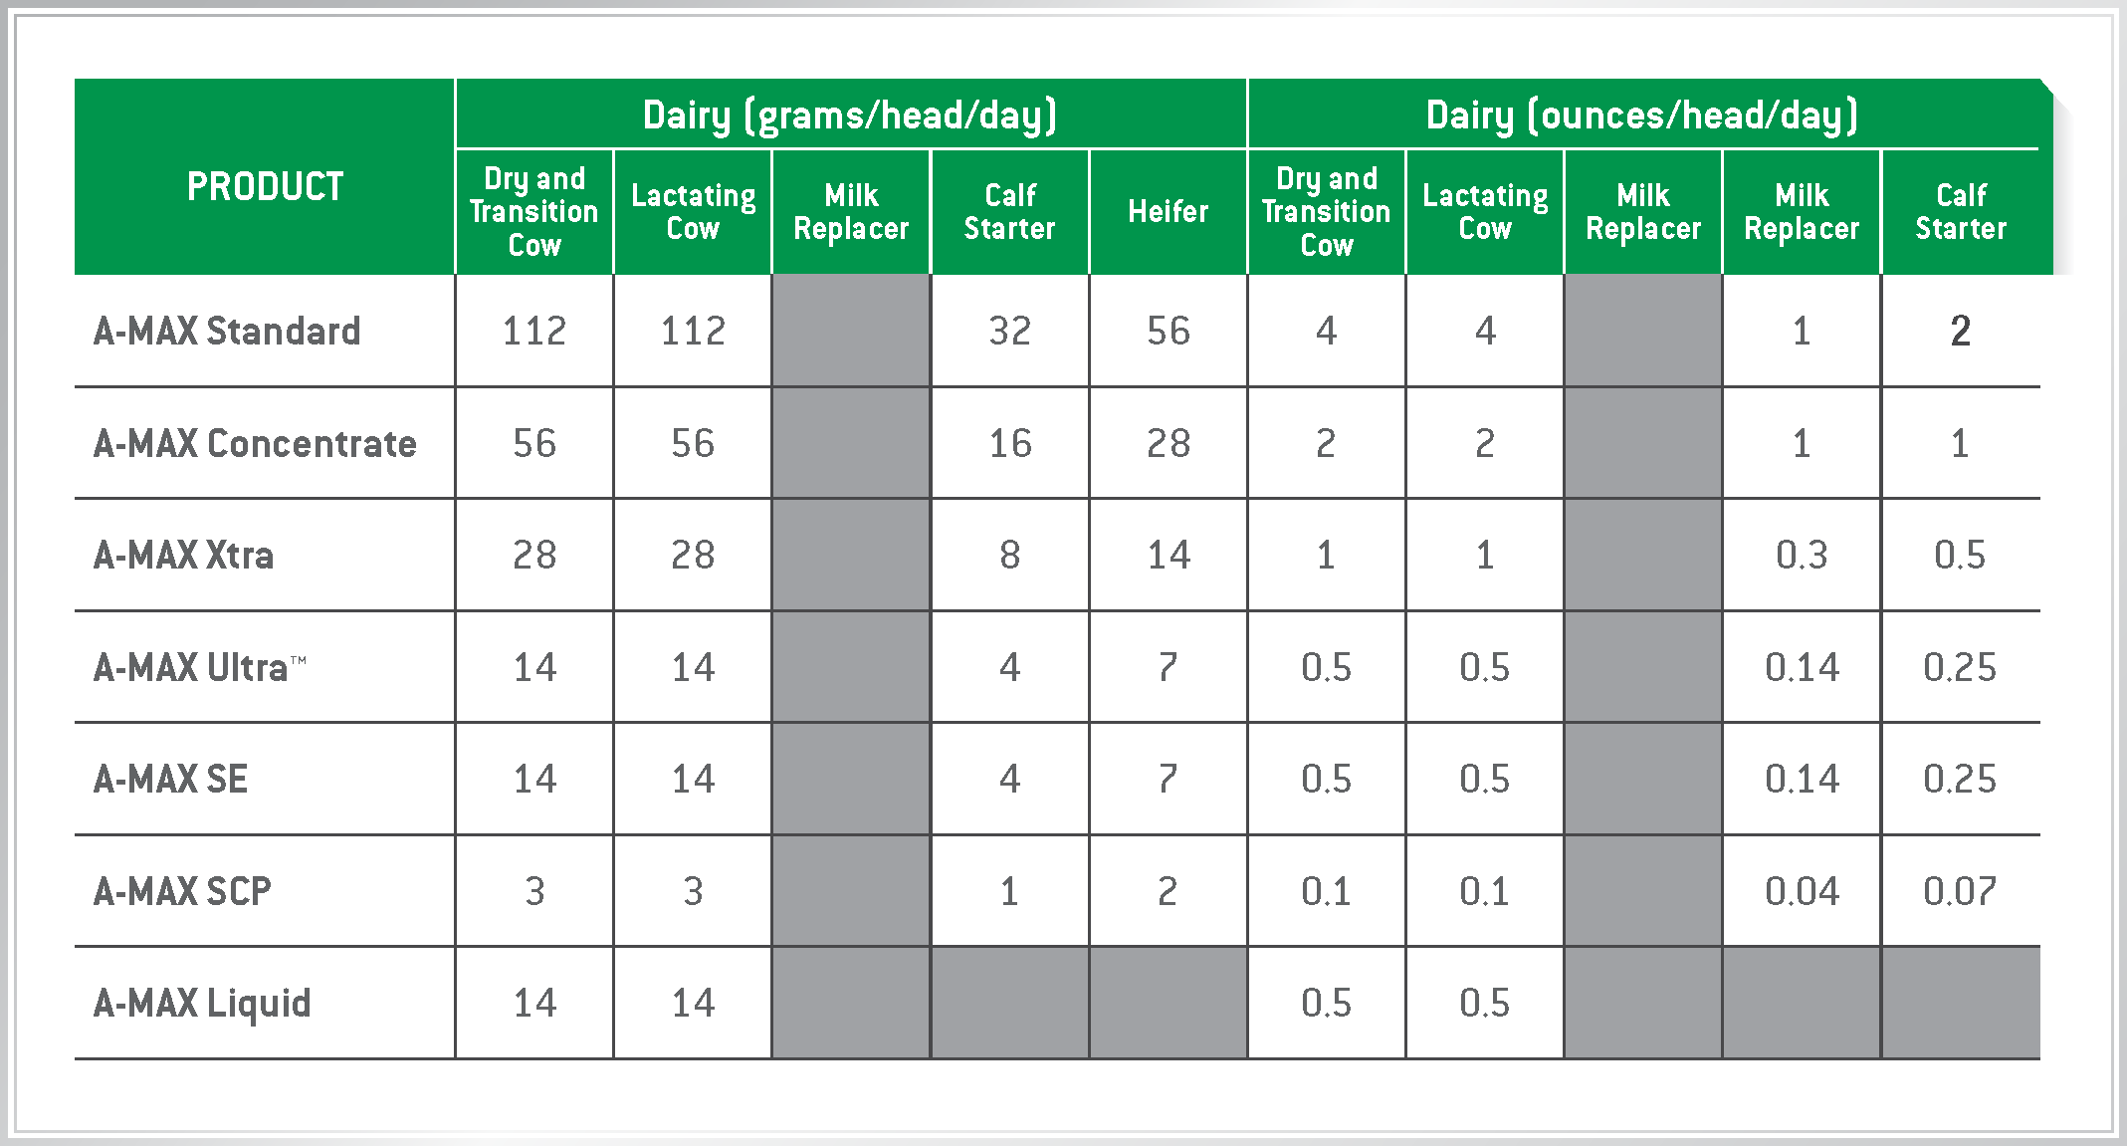
Fuel up: recommended feeding rates

Slide 14
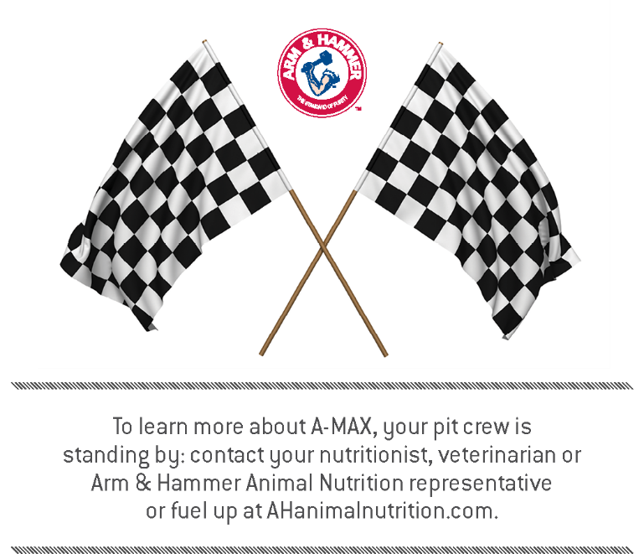
Questions?

Slide 15
THANK YOU!

